Slide 1


Why choose UQ?
Most awarded teachers in Australia
#1 in
Queensland
for graduate employability
UQ ranks…
#1 in Queensland
#1 in Australia
#43 in the world
World-class facilities and beautiful,
heritage-listed campuses
Leaders in research
According to QS World University Rankings 2024 and AFR Best Universities Ranking 2023.

Slide 2



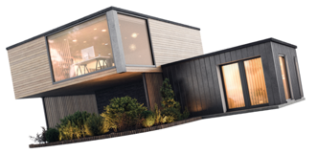
Areas of study
Discover what interests you
Agriculture and Animal Sciences
Architecture, Design and Urban Planning
Arts, Humanities and Social Sciences
Business and Economics
Communication, Media and Experience Design
Computer Science and IT
Education
Engineering
Environment
Health and Medicine
Law
Science and Mathematics
Notes:
Speaking notes
So what exactly can you study at UQ? Let’s take a closer look.

Slide 3
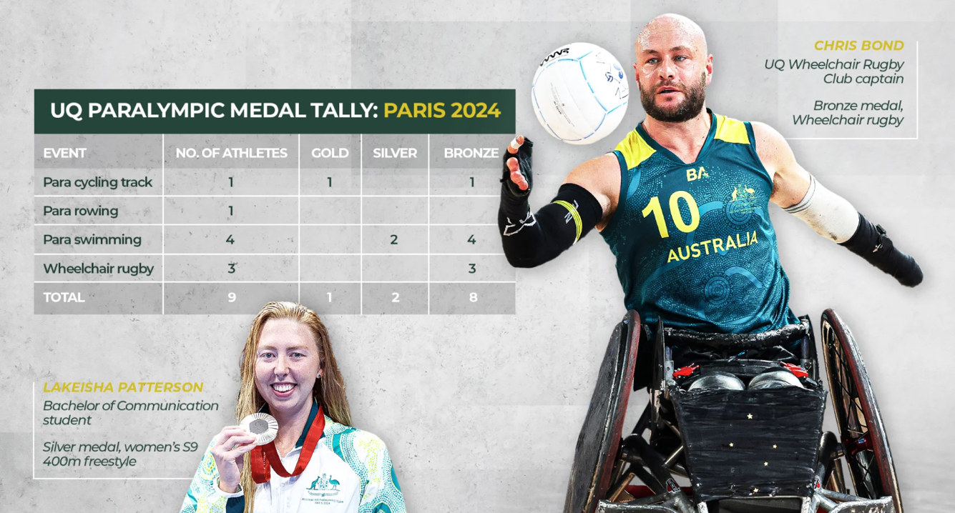
UQ Alumni, Club Members, Staff & Current Students
Images from: UQ Contact Magazine
Notes:
UQ Alumni, Club Members, Staff & Current Students
3 Elite UQ Student-Athletes (all medaled)

Slide 4
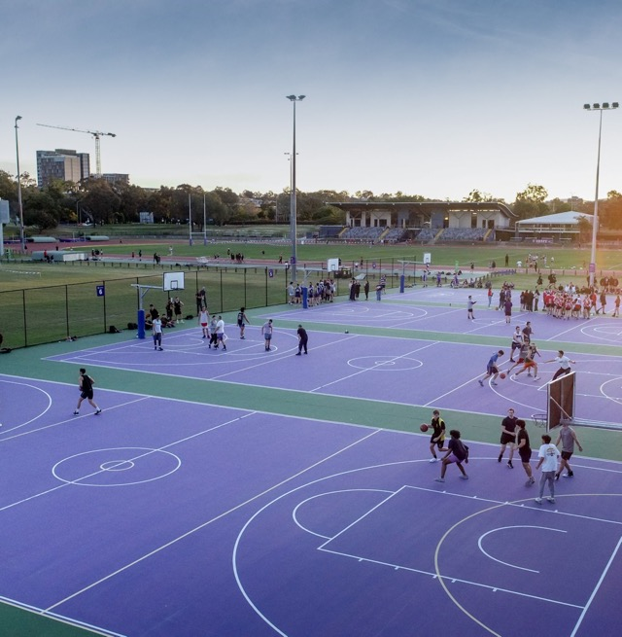
UQ Sport
Largest multi-sport campus
Competitive sport
Social sport
Elite Athlete Program
80+ group fitness classes
per week
A three-level weights
and cardio gym
An Olympic-standard
athletics track
50m + 25m pools
9 sporting fields
21 tennis courts
New world-class, integrated health, wellbeing and sports facility opening soon
Notes:
Sport is a big part of the UQ identify. Located at UQ’s St Lucia and Gatton campuses, UQ sport offers the UQ community a variety of options to keep fit and meet new people whilst you study at university!
This includes;
- more than 70 sports and activities (including 80+ group fitness classes per week!)
- 5 social sport options and almost 40 sporting clubs
- a three-level weights and cardio gym at the St Lucia campus
- two swimming pools (with a third pool under construction!)
- an Olympic standard athletics track
- nine sporting fields and 21 tennis courts
Construction is also underway for UQ to be home to a new world-class, integrated health, wellbeing and sports facility, projected to be completed in 2022.

Slide 5

Elite Athlete Program: Overview
The University of Queensland is endorsed by the Australian Institute of Sport as part of the Elite Athlete Education Network.
Designated Elite Athlete support staff to provide student-athlete advocacy as per UQ Reasonable Adjustments - Students Procedure.
Free UQ Sport 12-month Gold Membership – Pool, gym, track access
Athlete wellbeing support
Nutrition & Dietetic consultations
Discounted Strength and Conditioning program
Discounted Sports Psychology consultations
Discounted Physiotherapy consultations
Personal and Professional development opportunities
Competition Subsidy funding program
UQ provides Student Access Plans (SAPs)
2024 Year in Review
300+
Registered elite student-athletes
49 sports represented
Most popular Program: Bachelor of Engineering (Honours)

Slide 6
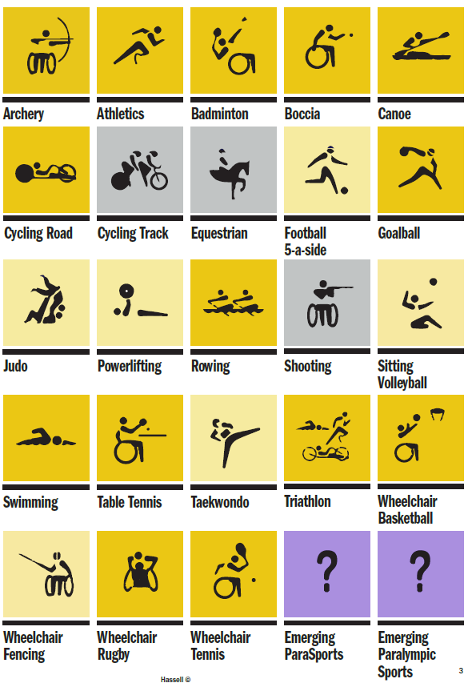
Coming soon…
20 of 23 Paralympic sports catered for on campus
Gold = currently in action
Yellow = facility capability in centre
Grey = no facilities planned

Slide 7
Key takeaway
Elite Athlete Program + Student Access Plans = Supported learning
We are here to help you balance your study and your sport!

