Slide 1
Next Steps for Para-athletes
with Karan Anand from Hnry
November 2024
The information provided here is for general informational purposes only and does not constitute financial advice
Notes:
Design guidelines:
Persona on the right side of slide ✅
Title font size 48 (if it doesn’t fit, it’s too long so make use of the secondary title)✅ Secondary title font size 20 ✅
Name/date font 16 ✅
Extra:
Please leave the footer where it is OR you can delete the green rectangle but please keep the words on the left where they are.
Leave the logo in the top left corner, this may be changed for the name only logo.
Persona image should align with the bottom of the page.
More example title pages on following 2 slides.

Slide 2
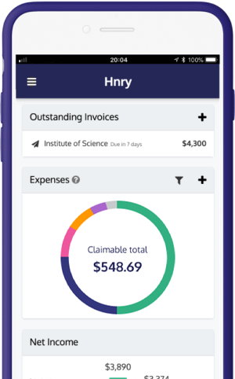
Hnry’s category-defining solution
Hnry is the world’s first all-in-one digital accounting service, taking care of sole traders’ tax and compliance, so they can focus on getting the job done
Hnry brings together payments, accounting tools and professional accountancy
Hnry Accounts
Web & Mobile App
Expert Service
Every user gets a unique account into which they receive all of their self-employed income
Every inbound payment triggers automated tax calculations & payments
Each user has the ability to accept payment via online card facilities
Right-sized tools, tailored for self-employed individuals
Invoicing and Quoting, Expense Management and Financial Management
Personalised insights to help users better manage their finances
Support across tax, payments and technical queries, enabled by high degrees of automation
Tax filings and representation to tax authorities, provided by expert accountants
The information provided here is for general informational purposes only and does not constitute financial advice

Slide 3
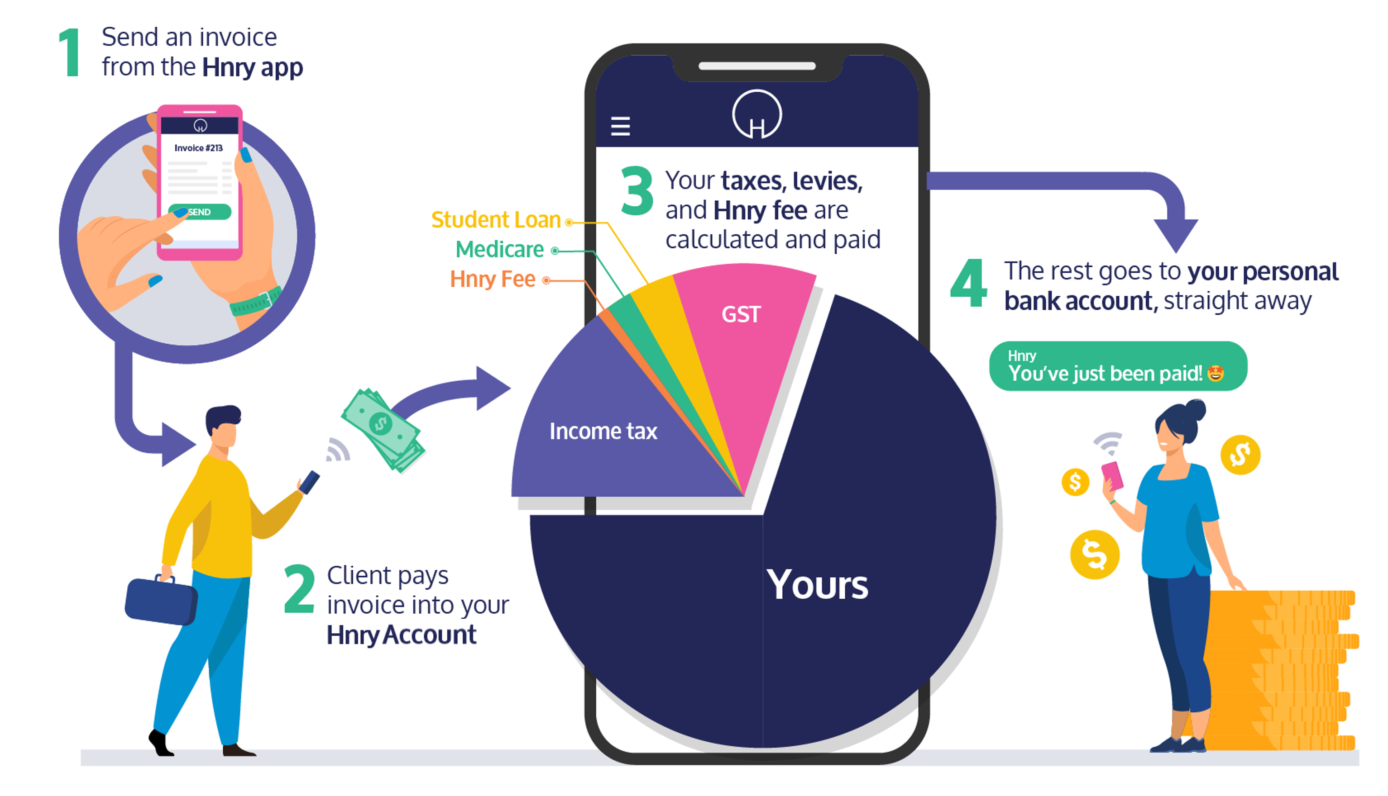
What we do for Athletes
The information provided here is for general informational purposes only and does not constitute financial advice
Notes:
We do all of this while investing in understanding the unique pain point and needs of our customer. Not all sole traders are the same - and we are continually learning about the specific needs of athletes and sportspersons

Slide 4
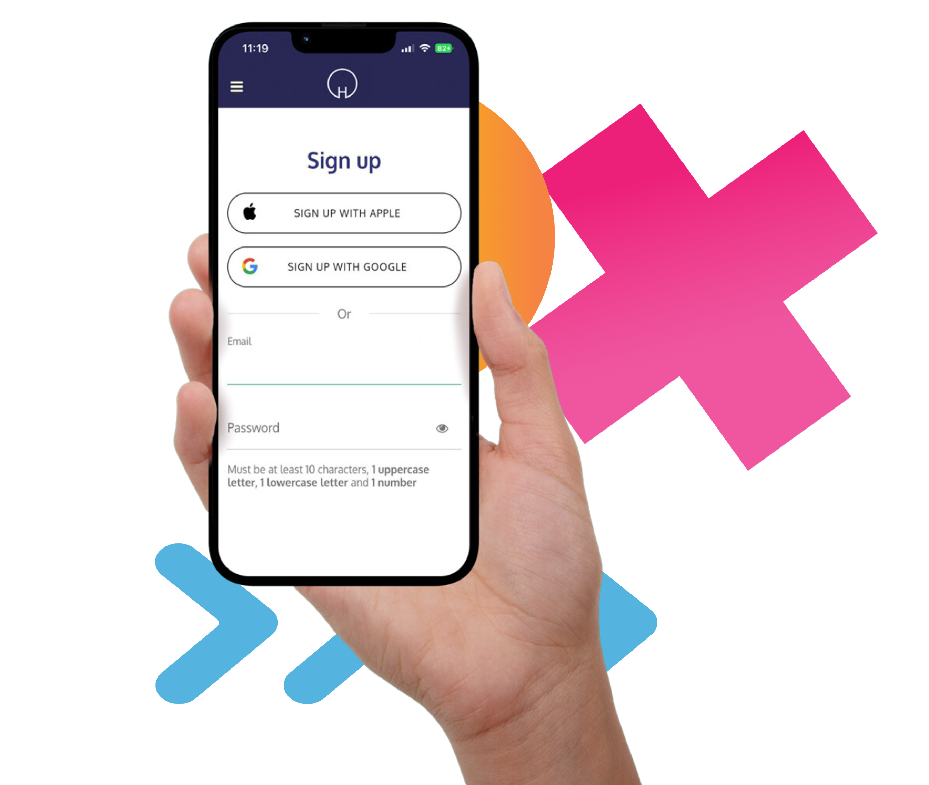
Thank you
For more info, go to https://hnry.com.au/ais/
Use Promo Code ‘AIS’ to get your first $5,000 in payments processed for free in Hnry!
If you have any further questions, please reach out to support@hnry.com.au

